Slide 1

DATA ANALYSIS
Food Delivery Company
A data-driven look at how orders move from restaurant to doorstep
Team Members: Project Supervisor:
Alaa Mohamed Fekry
Malak Emad Kamal
Amira Mohamed Ismail
Mohamed Ehab Mahmoud
Maryam Ramadan Ahmed
Esraa Eleraky

Slide 2



Project Overview
Food delivery is a courier service in which a restaurant, store, or independent food-delivery company delivers food to a customer. Orders are typically placed through a restaurant or grocer's website or mobile app, or through a food ordering platform.
Order Placed
App or website
Prepared
Restaurant or store
Delivered items can include entrées, sides, drinks, desserts, or grocery items, typically packaged in boxes or bags. Couriers usually drive a car, though in denser cities — where restaurants and homes sit closer together — bikes or motorized scooters are common.
Packaged
Boxes or bags
Delivered
Car, bike, or scooter

Slide 3
SECTION 01
Data Cleaning using python
Preparing the raw delivery dataset in Python (pandas) for analysis

Slide 4
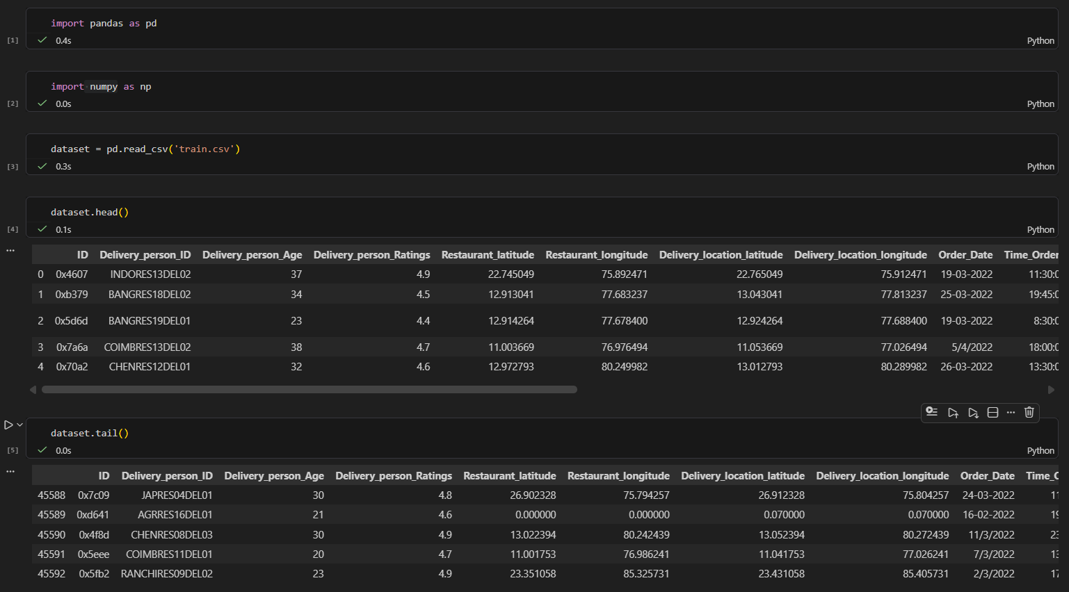
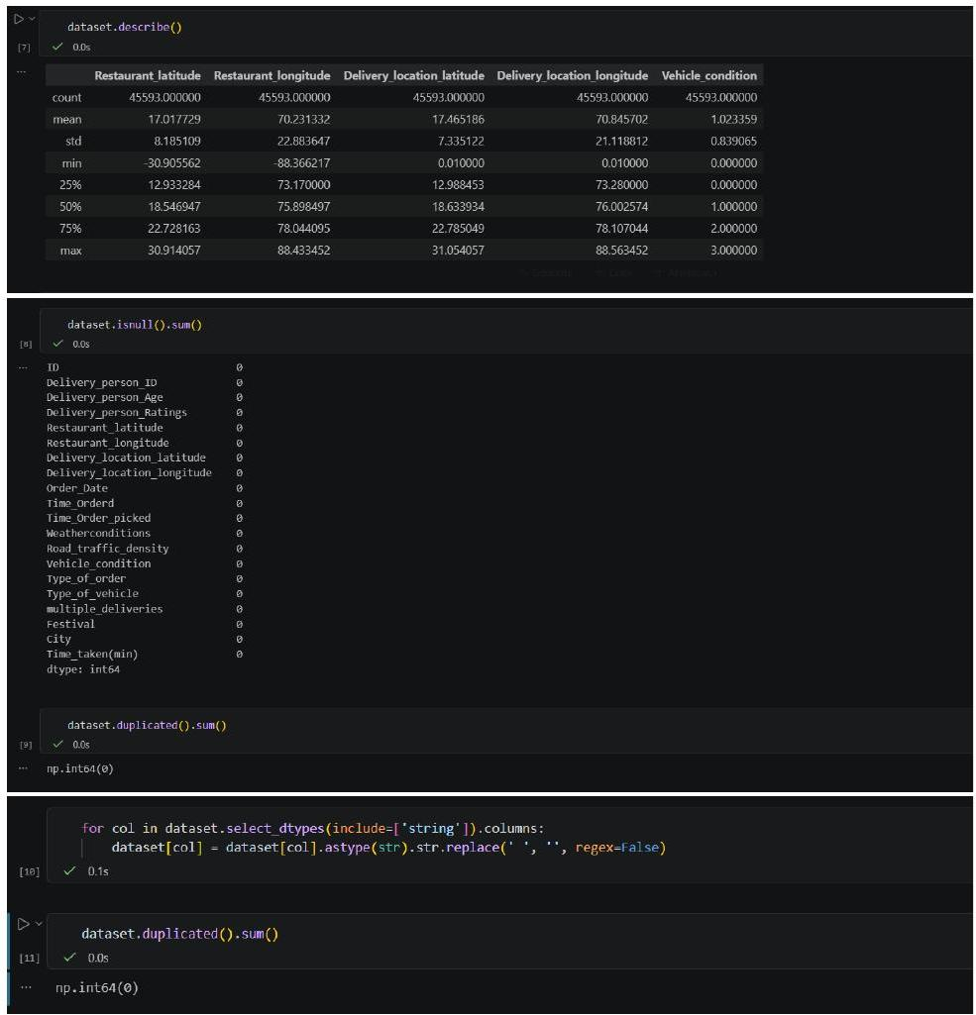
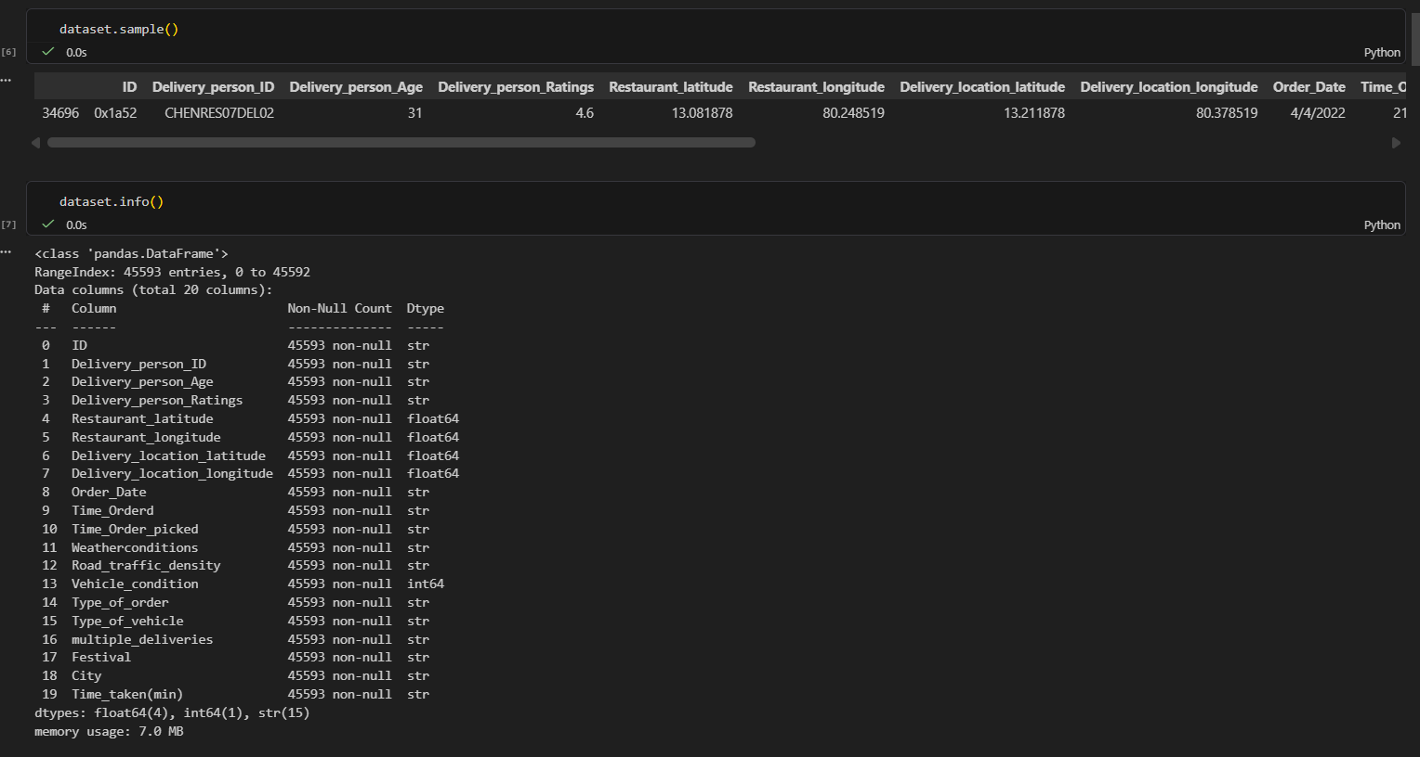
Loading & Exploring the Dataset
Insight: The raw dataset has 45,593 rows and 20 columns covering rider, order, and delivery details, with a mix of text, float, and integer types.
Recommendation: Run dataset.info() and .describe() early to confirm column types and spot issues before diving into cleaning.
Insight: Several text columns contained hidden extra whitespace that could break grouping and matching later.
Recommendation: Strip whitespace from every string column, then re-check for duplicate rows to make sure cleanup didn't hide any.

Slide 5
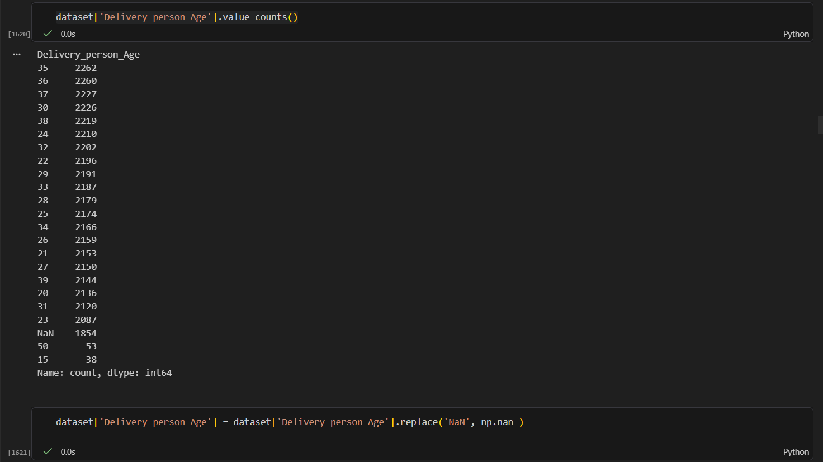
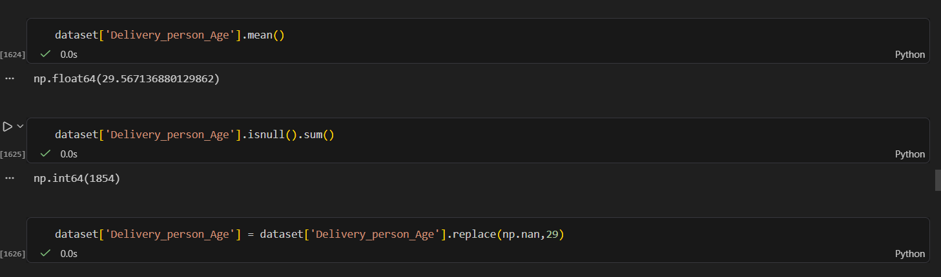
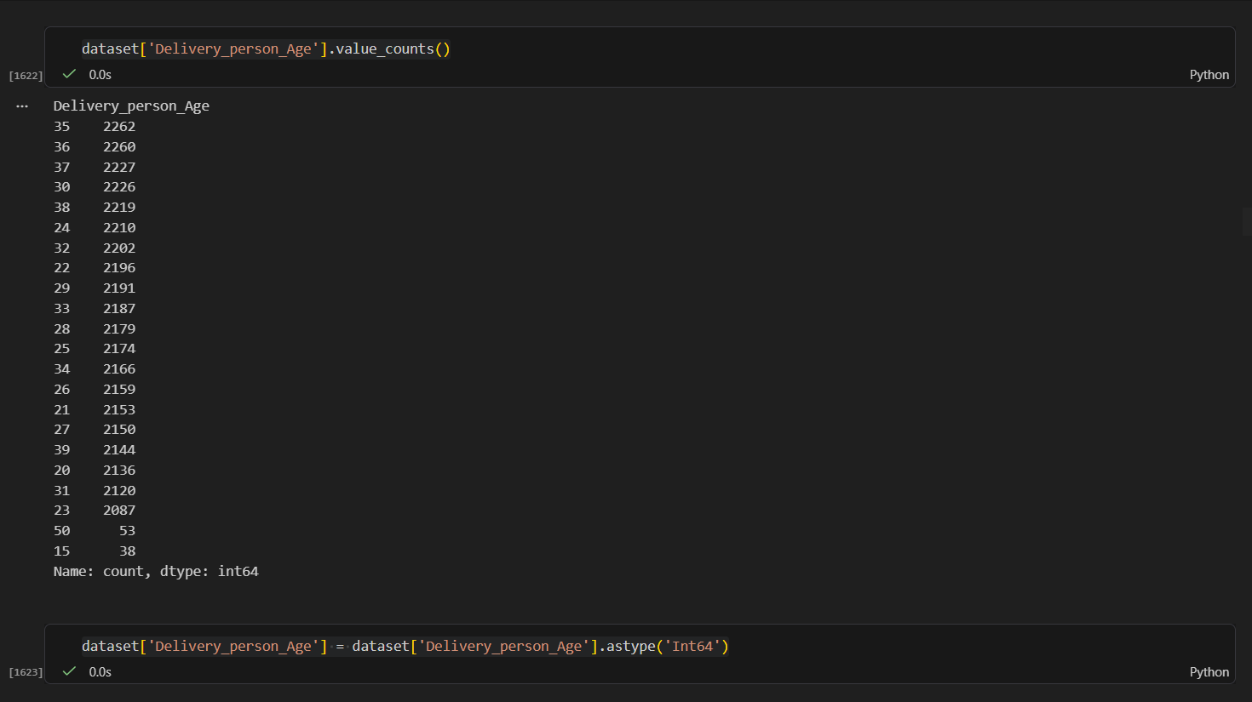
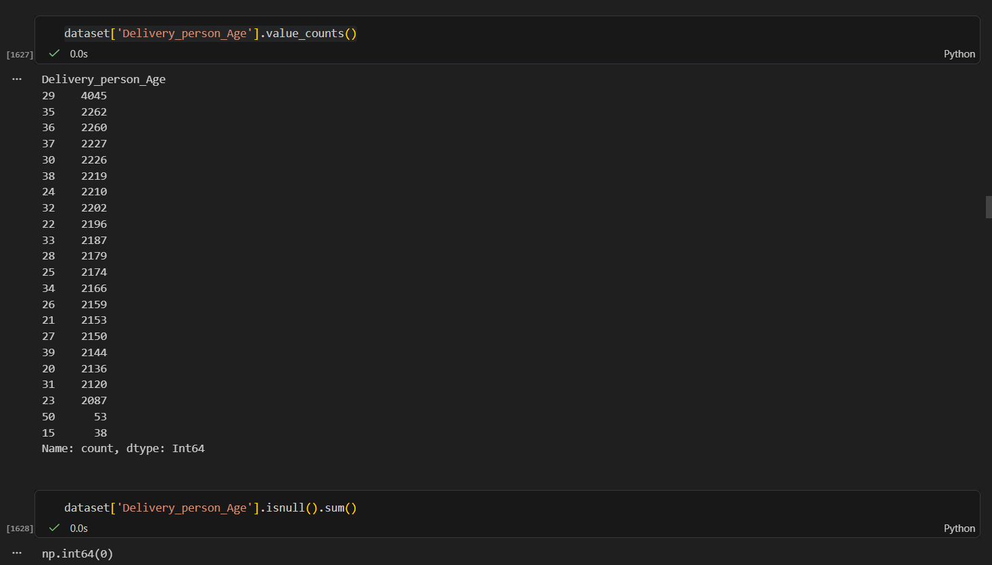
Fixing Ages
Insight: Delivery_person_Age stored its missing values as the text “NaN”, which hides them from a normal isnull() check.
Recommendation: Replace the text “NaN” with real np.nan first, so pandas can properly detect and count the 1,854 missing ages.
Insight: Ages ranged from teens to 50s, with those 1,854 gaps confirmed once the values were read correctly.
Recommendation: Fill the missing ages with the column mean (~30) and convert the column to int64 for clean numeric analysis.

Slide 6
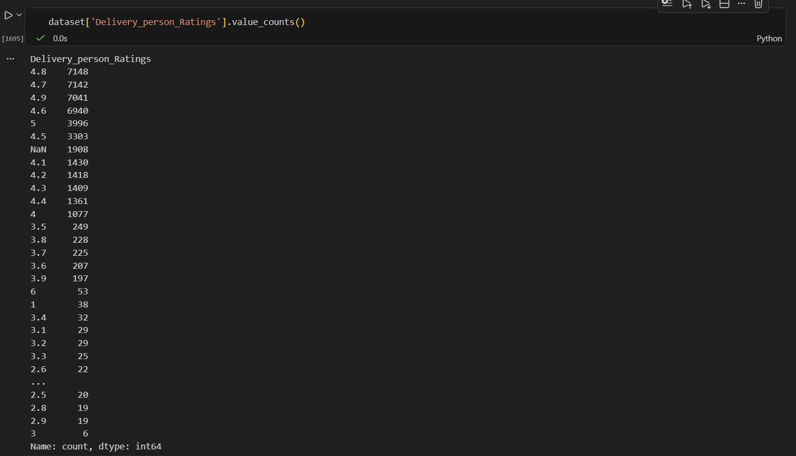
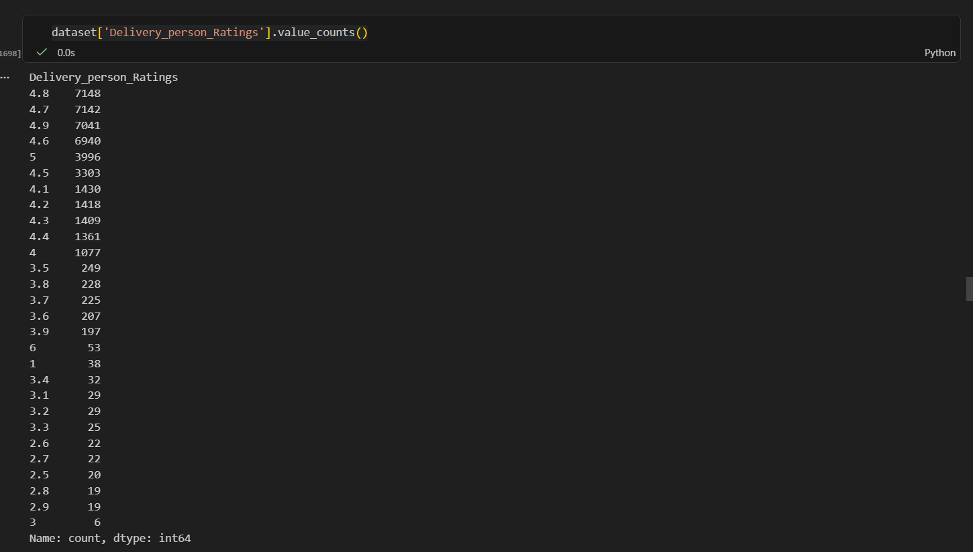

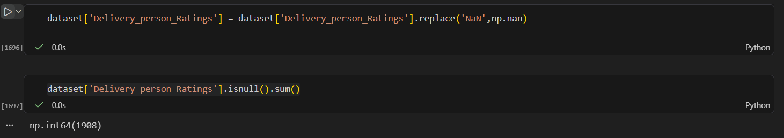
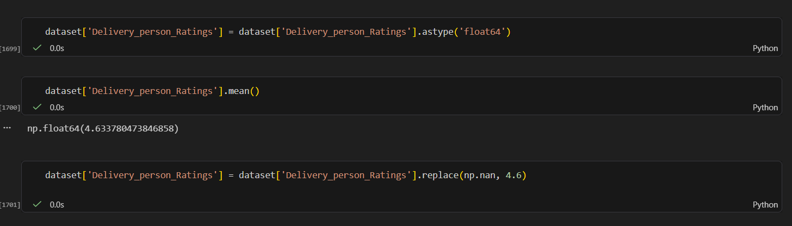
Fixing Ratings
Insight: Delivery_person_Ratings stored missing values as the text “NaN”, totaling 1,598 true nulls once converted properly.
Recommendation: Replace the text “NaN” with real nulls, then fill the gaps with the column mean (~4.63) instead of dropping those rows.
Insight: A recheck with isnull().sum() after filling confirmed zero missing ratings remain.
Recommendation: Cast the cleaned column to float64 to keep rating calculations consistent in later analysis.

Slide 7
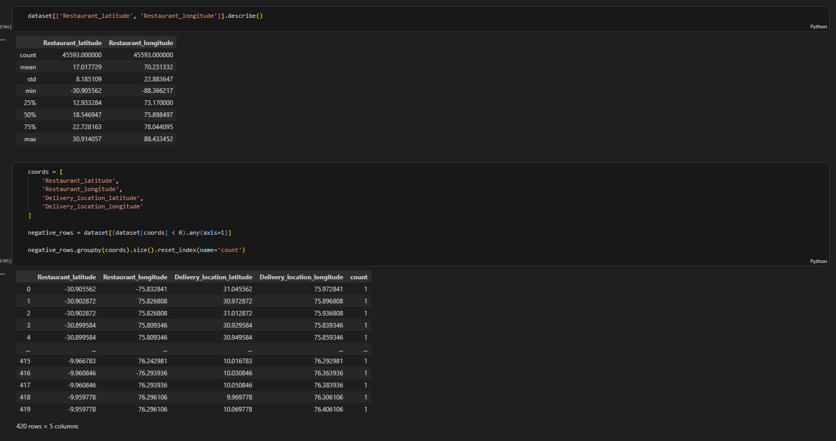
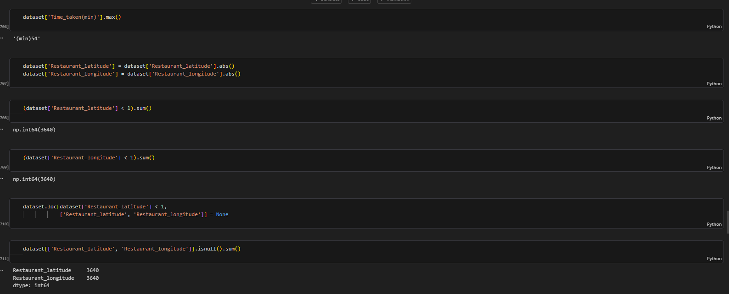
Fixing Coordinates & Delivery Duration
Insight: A batch of restaurant coordinates were stored as negative values (430 distinct rows), which would place restaurants in the wrong hemisphere on a map.
Recommendation: Apply abs() to correct the sign instead of dropping those rows, since the magnitude of the coordinate is still usable.
Insight: After the fix, 3,640 restaurant coordinates were still under 1 — too close to (0,0) to be real store locations.
Recommendation: Mark those specific latitude/longitude values as missing (NaN) so they don't distort distance calculations later.

Slide 8
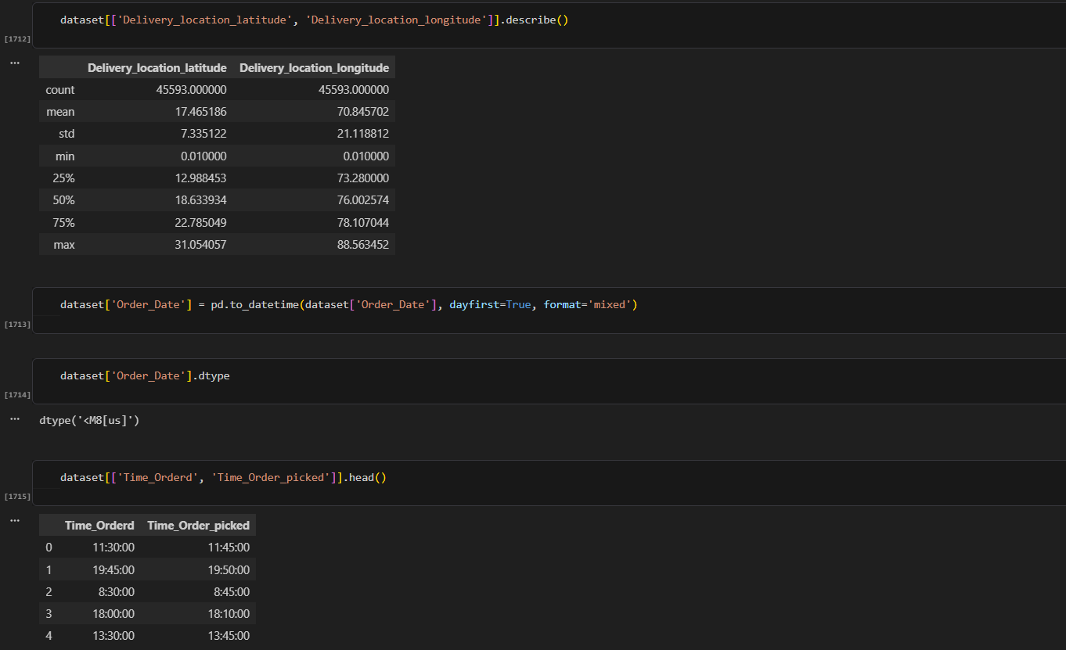
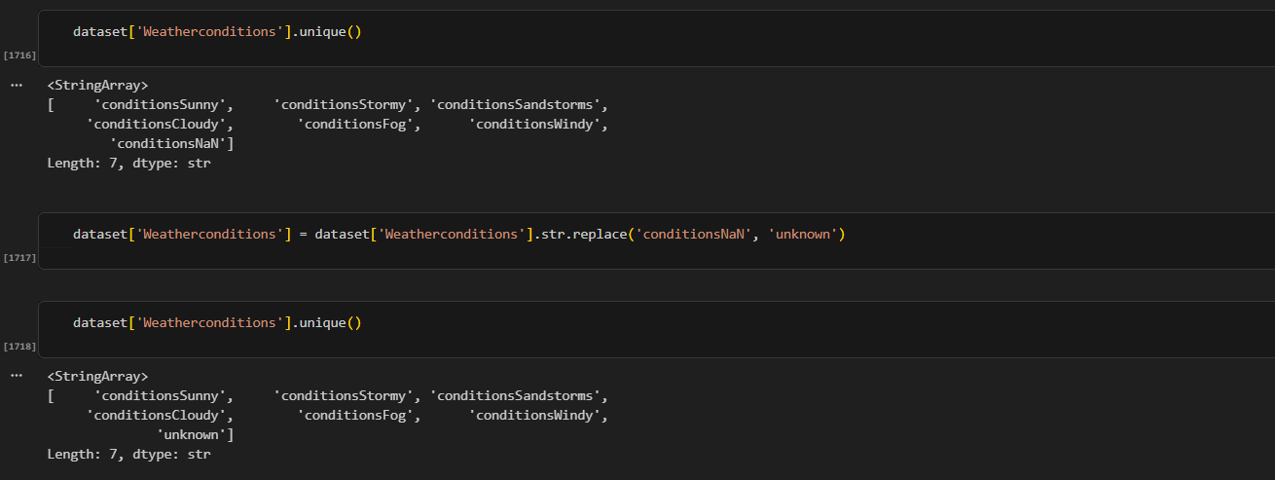
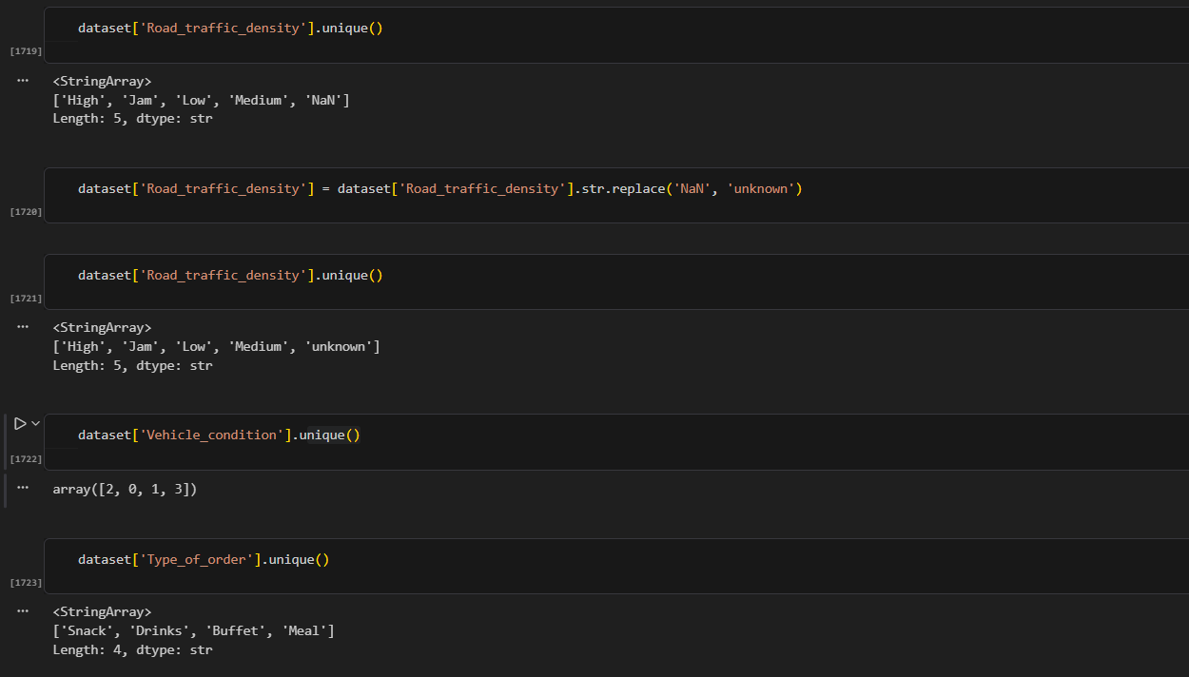
Fixing Weather, Traffic & Dates
Insight: Weatherconditions and Road_traffic_density both stored missing values as the text “conditionsNaN” / “NaN” rather than a real null.
Recommendation: Replace those placeholder strings with an explicit “unknown” category so they read clearly and don't break groupby operations.
Insight: Order_Date was stored as plain text, which blocks any date-based filtering or trend analysis.
Recommendation: Convert it with pd.to_datetime() so order timing can be grouped and compared accurately later.

Slide 9
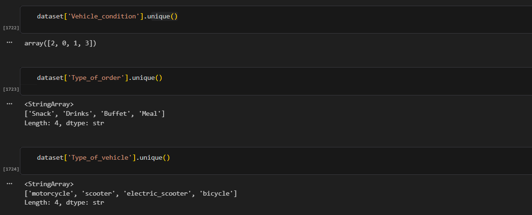
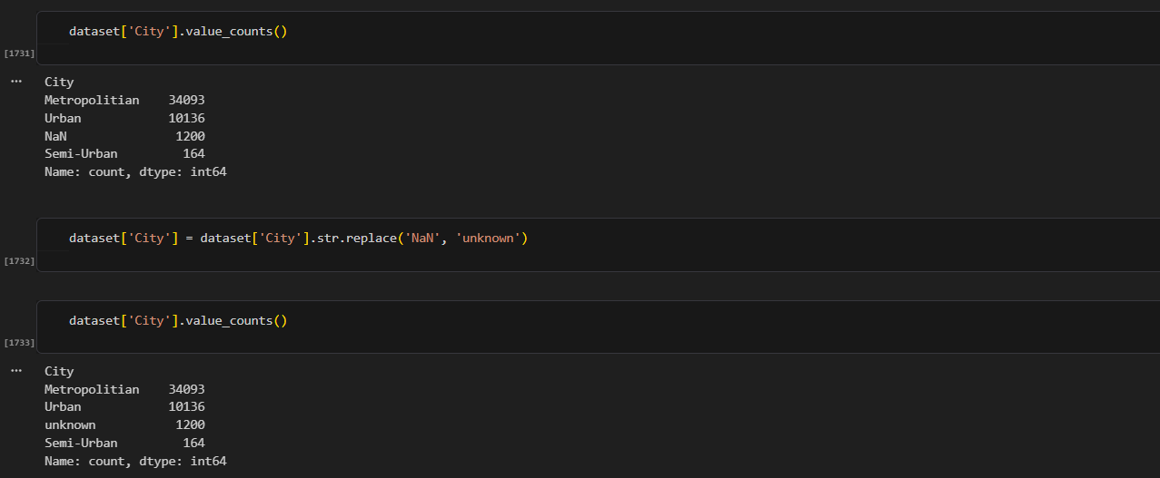
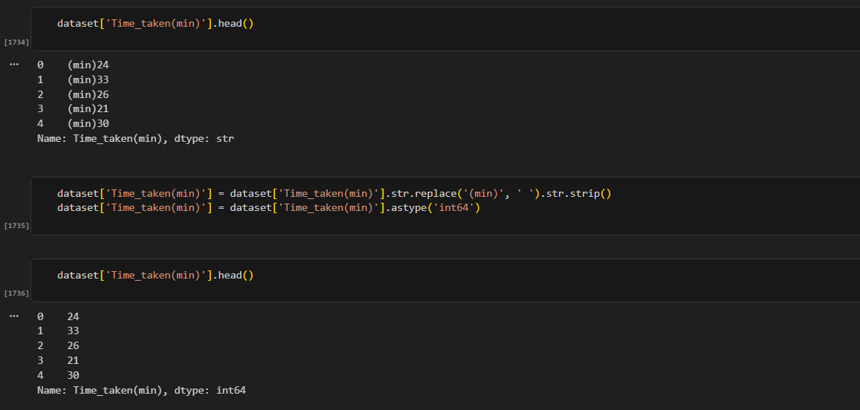
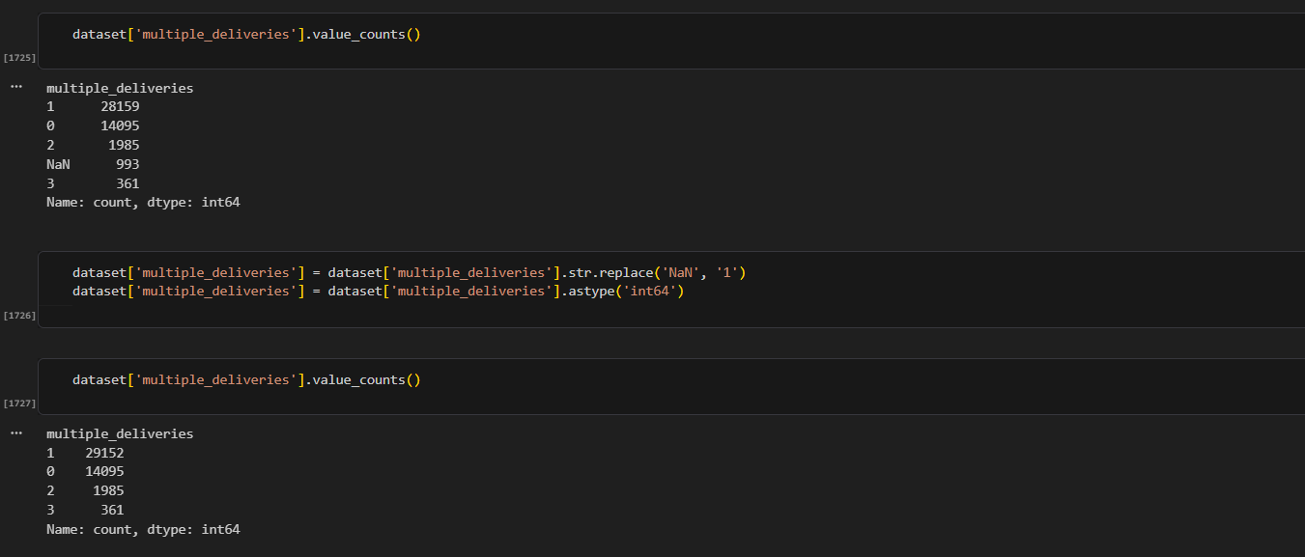
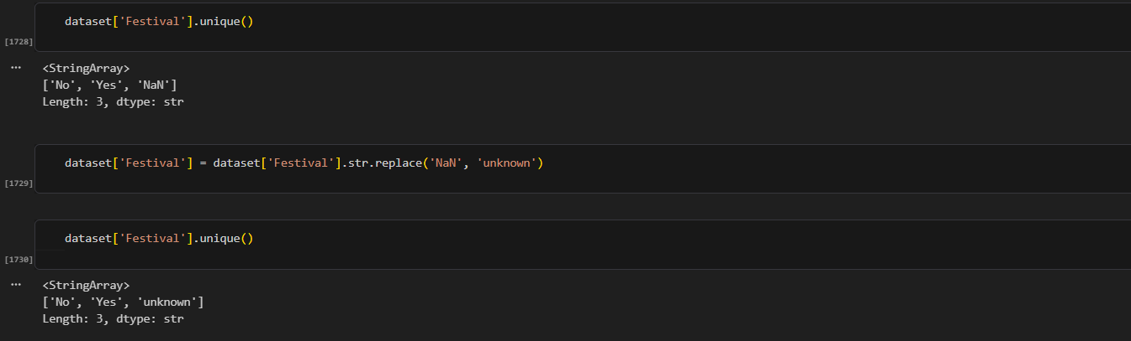
Fixing City, Festival & Delivery Time
Insight: multiple_deliveries had 993 missing entries, and City / Festival stored gaps as the text “NaN” instead of a real null.
Recommendation: Fill the missing multiple_deliveries with 1 (the most common value), and relabel City/Festival's “NaN” entries as “unknown” before converting types.
Insight: Time_taken(min) — the key delivery-time metric — was stored as text like “(min) 24” instead of a number.
Recommendation: Strip the “(min)” text and convert the column to int64 so it can be used directly in time calculations.

Slide 10
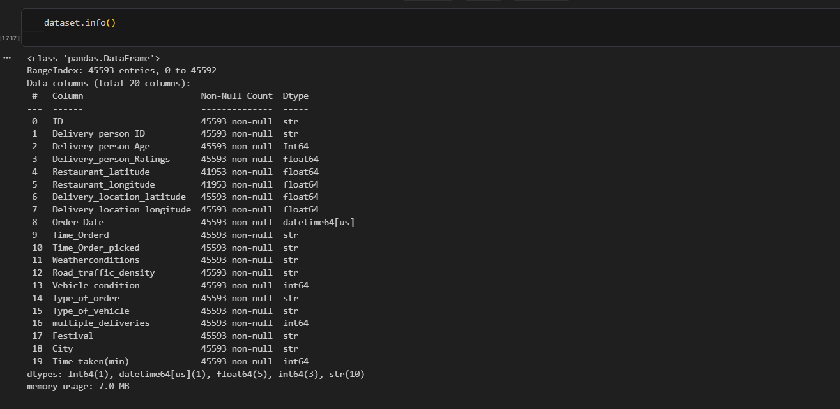
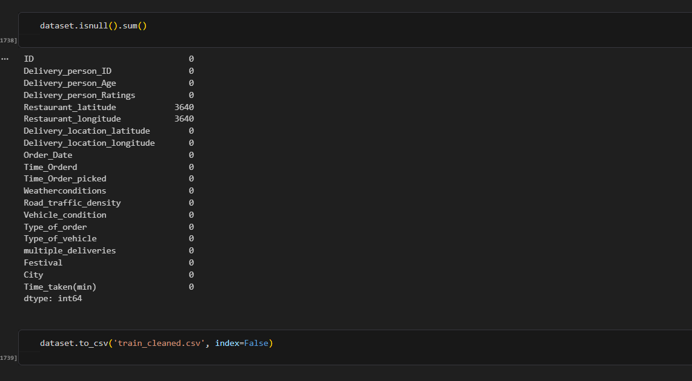
Final Clean Dataset & Export
Insight: The final dataset.info() and isnull().sum() checks confirm all columns are fully populated, aside from the 3,640 coordinate values intentionally set to null.
Recommendation: Always re-run these checks right before export to confirm nothing was missed earlier in the pipeline.
Insight: The cleaned dataset is now ready for deeper analysis in SQL, Power BI, and Excel.
Recommendation: Export it with dataset.to_csv('train_cleaned.csv', index=False) so every downstream tool works from one consistent source file.

Slide 11
SECTION 02
Data Analysis using SQL
Querying the cleaned dataset to uncover delivery performance patterns

Slide 12
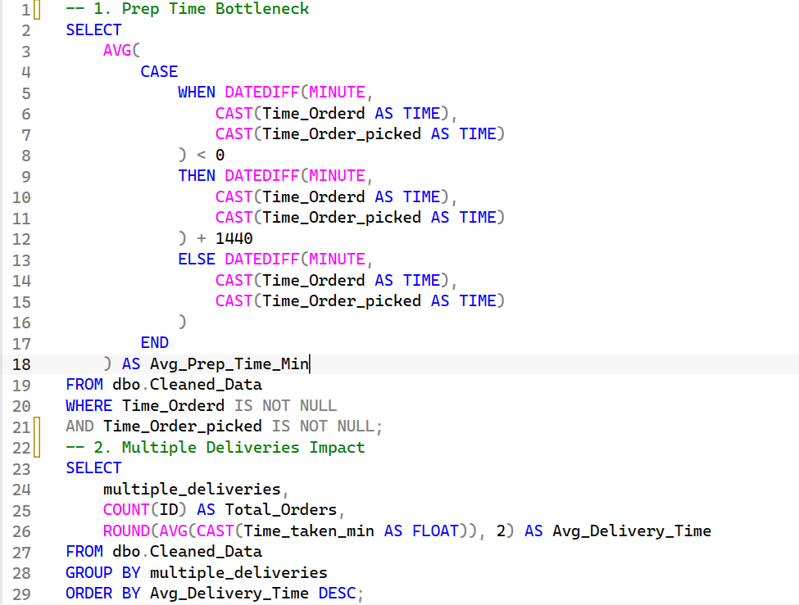
PART 1 · QUERY ANALYSIS
Prep Time & Multiple Deliveries
Insight: Average preparation time is around 9 minutes, indicating that restaurant preparation contributes to the overall delivery time.
Recommendation: Improve restaurant preparation speed with standard prep-time targets and optimize rider assignment timing to cut waiting time.
Insight: Orders with multiple deliveries show higher average delivery times, indicating that combining orders may increase delays.
Recommendation: Cap the number of orders assigned to one rider, and only combine deliveries that fall along the same geographic route.

Slide 13
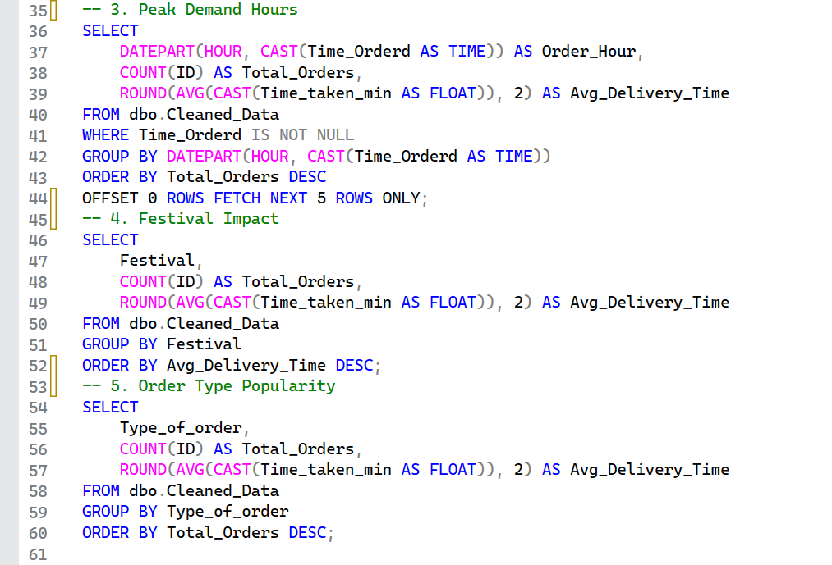
PART 1 · QUERY ANALYSIS
Peak Hours, Festivals & Order Type
Insight: The highest order volume occurs during evening peak hours (7 PM–11 PM), increasing delivery pressure and rider demand.
Recommendation: Increase rider availability during peak hours and offer promotions in low-demand periods to balance order volume.
Insight: Orders during festival periods have a higher average delivery time (45.52 min), showing festivals raise pressure and congestion.
Recommendation: Prepare additional riders during festival periods and adjust ETAs to reflect high-congestion conditions.
Insight: Snack orders have the highest volume, closely followed by Meal and Drinks orders — demand is fairly similar across types.
Recommendation: Create offers and menus around the most popular categories, and work with restaurants to keep them well stocked.

Slide 14
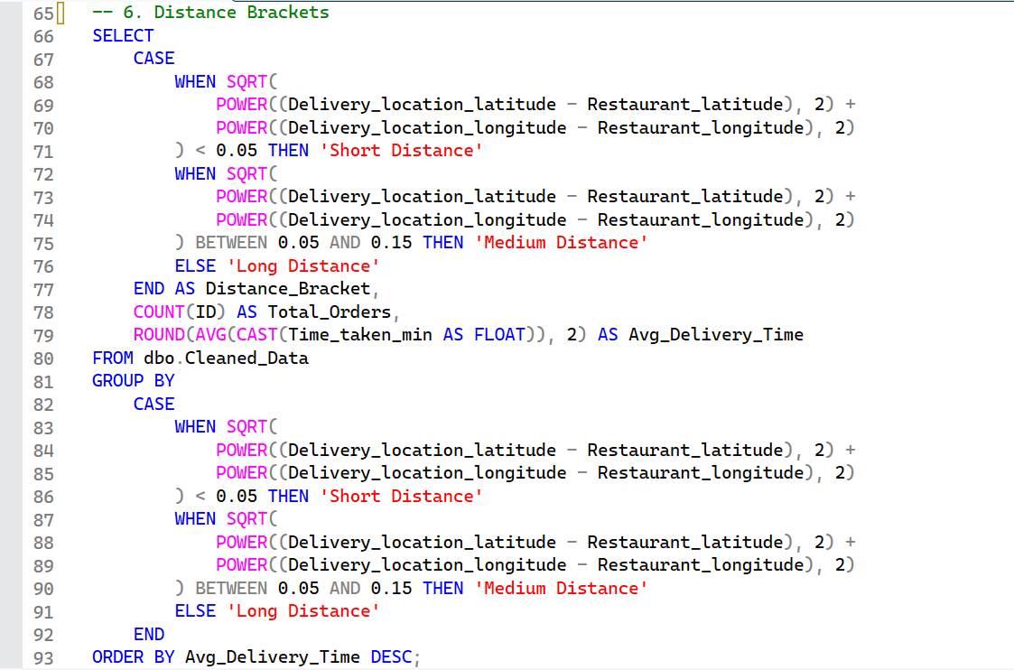
PART 1 · QUERY ANALYSIS
Distance Brackets
Insight: Long-distance orders have the highest average delivery time (28.69 min), showing distance negatively affects delivery efficiency.
Recommendation: Increase delivery fees as distance grows, and prioritize nearby orders to improve overall delivery speed.

Slide 15
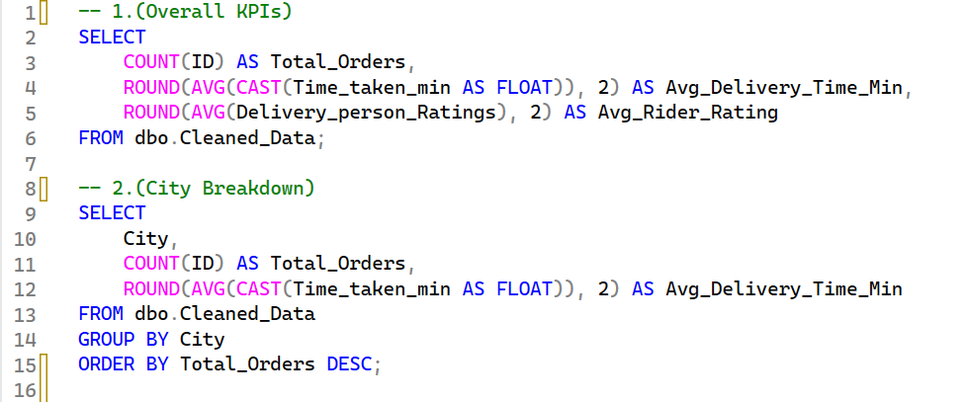
PART 2 · COMPANY-WIDE ANALYSIS
Overall KPIs & City Breakdown
Overall Efficiency & Geography
High order density in Metropolitan areas: the vast majority of deliveries are concentrated there, requiring localized hubs to maintain fast fulfillment.
Delivery time bottlenecks: average delivery times spike during severe traffic density and unfavorable weather, highlighting the need for dynamic route adjustments.

Slide 16
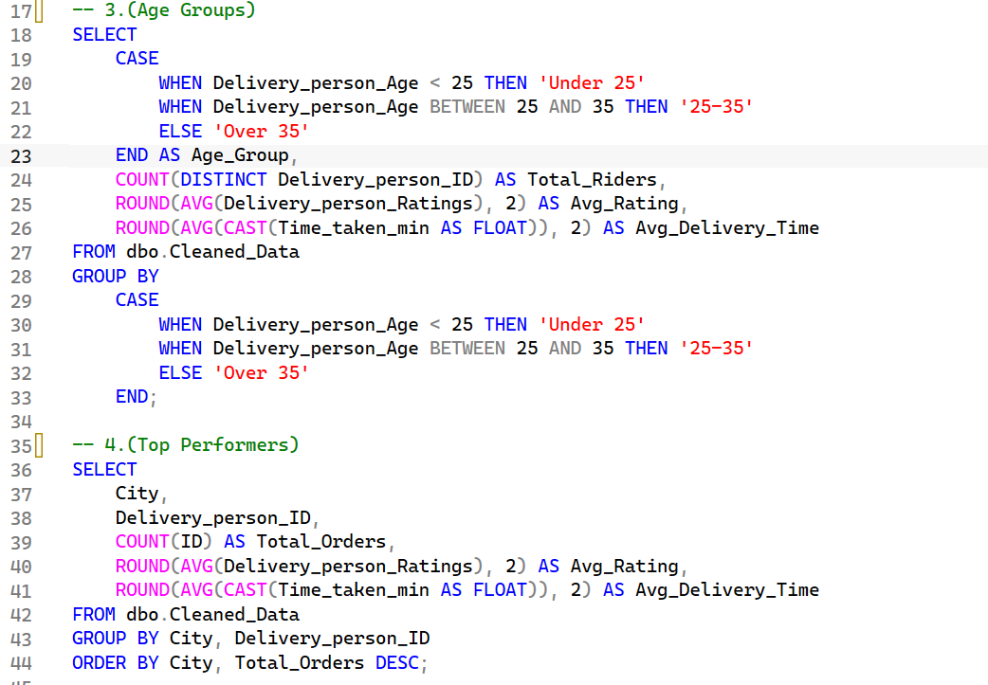
PART 2 · COMPANY-WIDE ANALYSIS
Age Groups & Top Performers
Rider Performance & Demographics
Age group dynamics: riders aged 25–35 handle the highest volume of orders while maintaining consistent rating performance.
Rating consistency: top-rated drivers consistently achieve lower average delivery times, showing a strong link between punctuality and customer satisfaction.

Slide 17
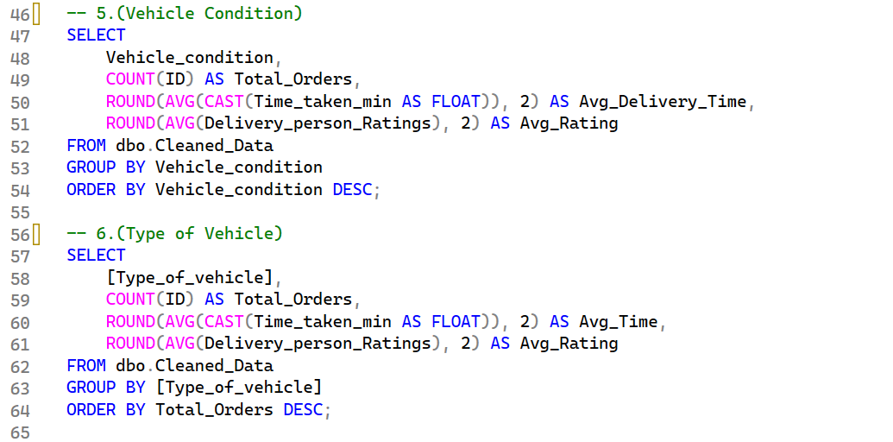
PART 2 · COMPANY-WIDE ANALYSIS
Vehicle Condition & Type
Fleet & Vehicle Utilization
Vehicle condition impact: vehicles in optimal condition (levels 2 & 3) reduce average delivery times compared to poorly maintained vehicles.
Vehicle type performance: electric scooters and motorcycles are more efficient in high-density traffic zones than standard bicycles.

Slide 18
PART 2 · COMPANY-WIDE ANALYSIS
Key Recommendations
1
Optimize Fleet Allocation
2
Preventive Vehicle Maintenance
Prioritize deploying motorcycles and electric scooters in heavy-traffic urban zones to reduce fulfillment delays.
Implement mandatory routine check-ups for company-provided fleets — better condition directly improves delivery speed.
3
Incentivize Top Riders
4
Dynamic Weather Routing
Create performance-based bonuses for riders maintaining ratings above 4.8 to improve retention and service quality.
Adjust estimated delivery times during adverse weather to manage customer expectations and prevent cancellations.

Slide 19
SECTION 03
Dashboard using Power BI
An interactive dashboard for exploring delivery performance at a glance

Slide 20
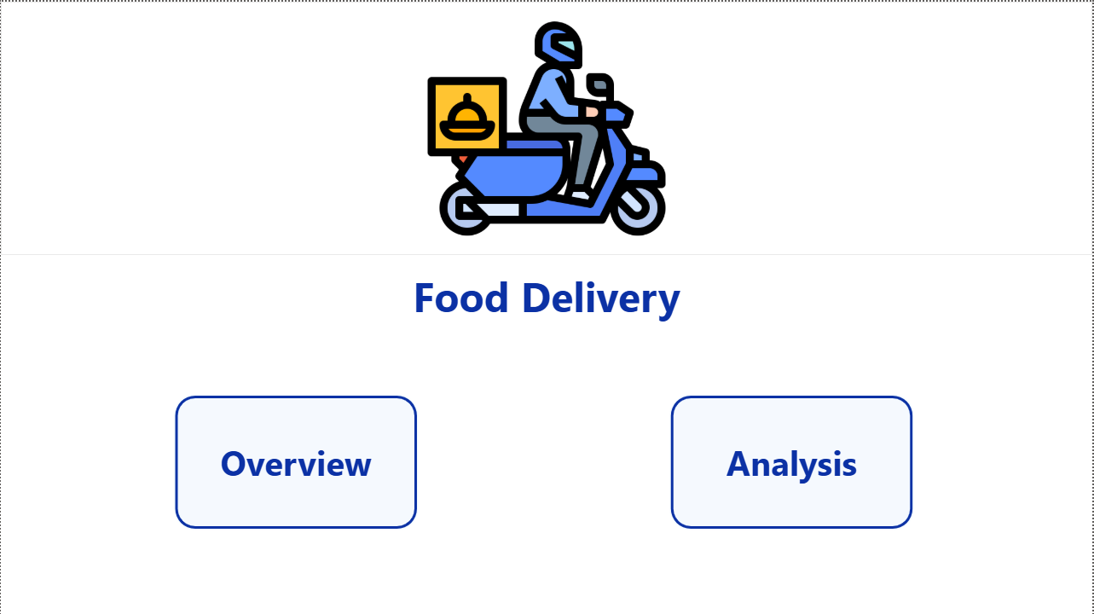
POWER BI DASHBOARD
Home
A simple landing page with navigation buttons to the Overview and Analysis pages.

Slide 21
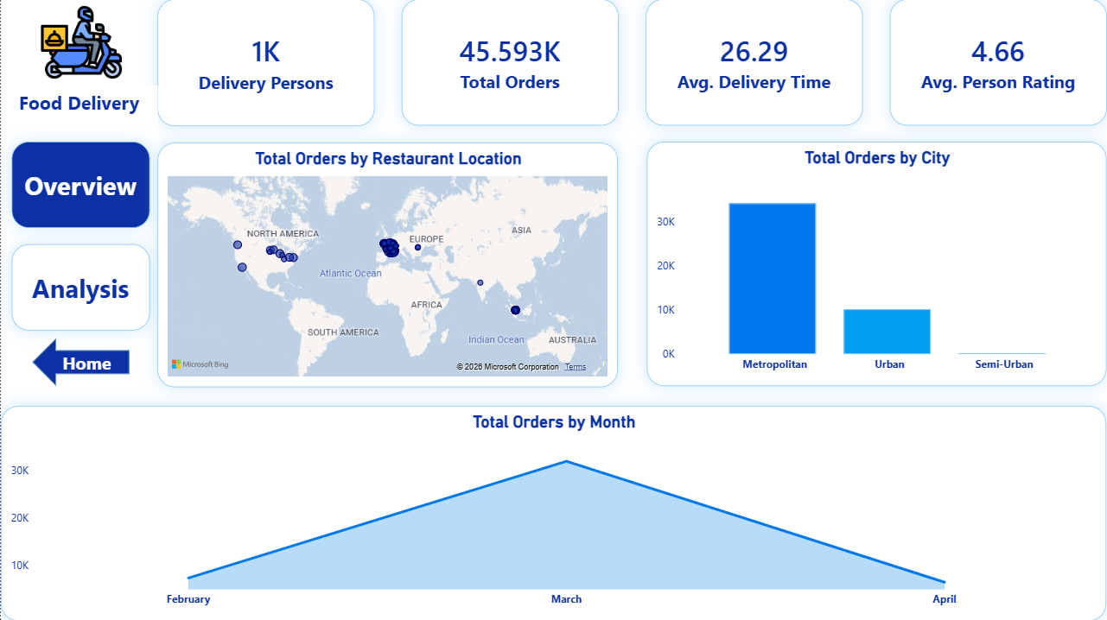
POWER BI DASHBOARD
Overview
Top-level KPIs — total orders, delivery persons, average delivery time and rating — alongside order volume by restaurant location, city, and month.

Slide 22
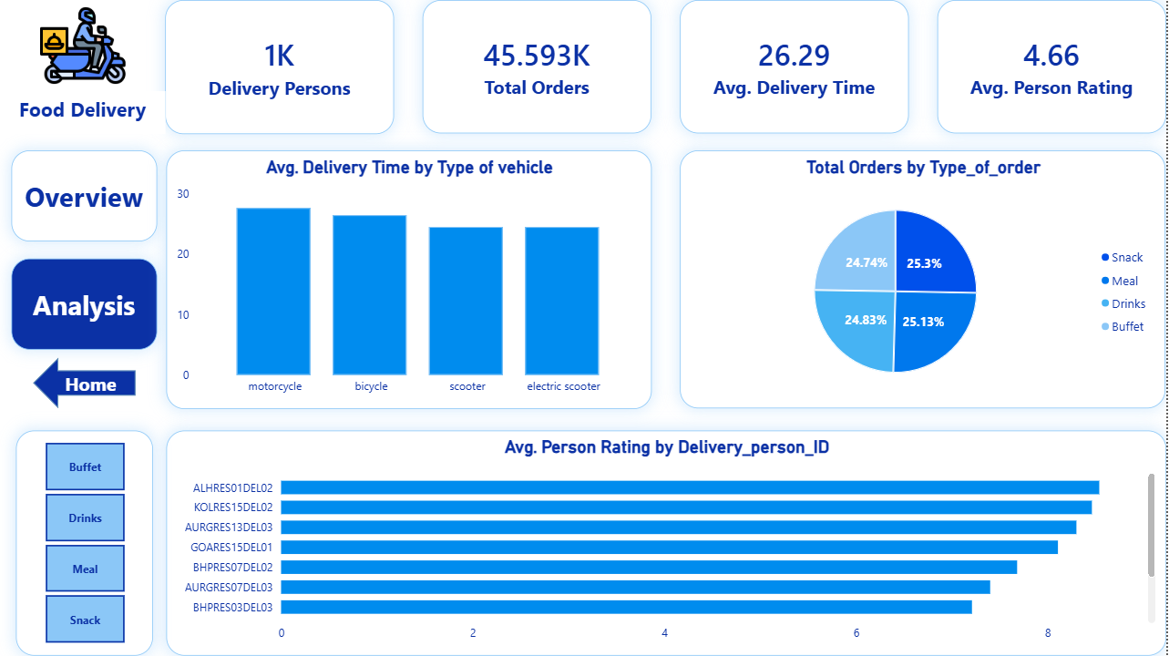
POWER BI DASHBOARD
Analysis
A deeper look at average delivery time by vehicle type, order-type distribution, and top-rated delivery persons.

Slide 23
SECTION 04
Dashboard using Excel
A self-contained operations dashboard built with PivotTables and slicers

Slide 24
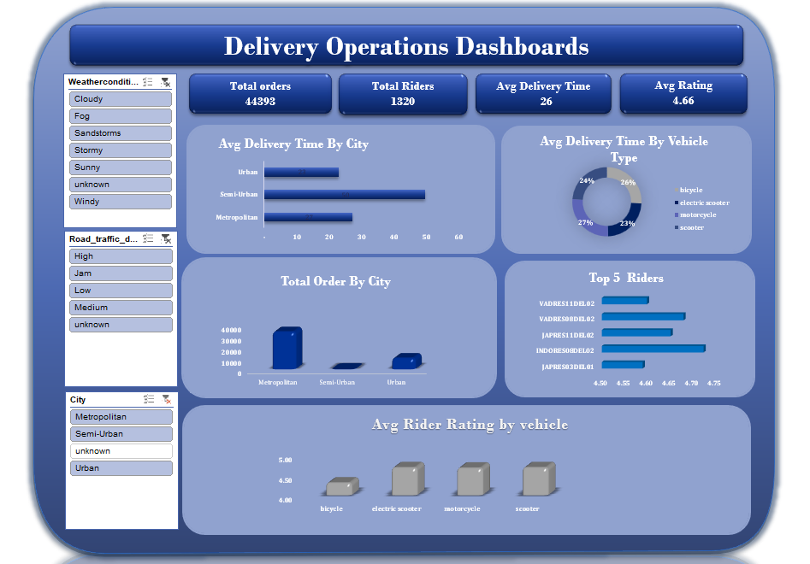
EXCEL DASHBOARD
Delivery Operations Dashboard
Filterable slicers for weather, traffic density, and city drive live views of total orders, average delivery time, average rating, and top-performing riders.

Slide 25
Team Contributions
Who worked on which part of the project
1
Data Cleaning (Python)
2
Data Analysis (SQL)
Alaa Mohamed Fekry
Malak Emad Kamal & Amira Mohamed Ismail
3
Dashboard (Power BI)
4
Dashboard (Excel)
Mohamed Ehab Mahmoud
Maryam Ramadan Ahmed

